Slide 1
논문들로 알아보는
Basic Algorithms of Semantic Segmentation
rayjang111@gmail.com
HyunSukJang

Slide 2
01
Introduction
.

Slide 3
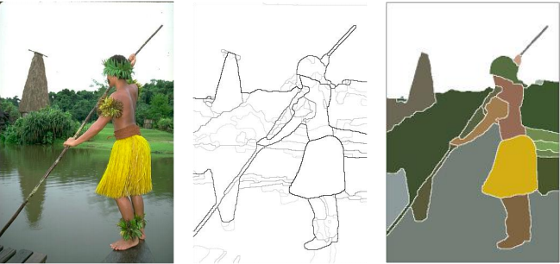
01.
Introduction
What is Semantic Segmentation??

Slide 4
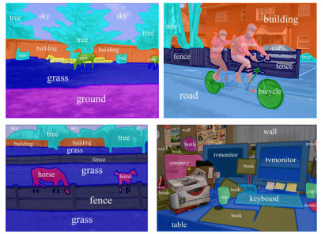
01.
Introduction
1.recognizing
2.understanding
what's in the image in pixel level.

Slide 5
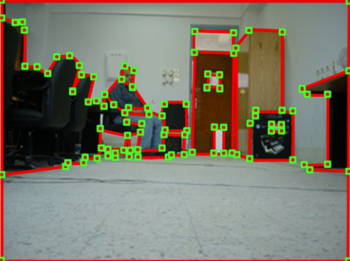
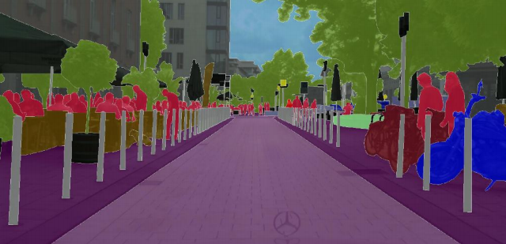
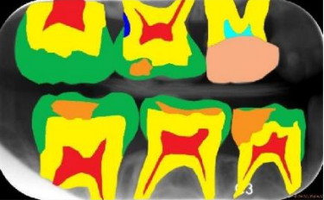
Applications of Semantic segmentation
robot vision and understanding
medical purposes (ISBI Challenge)
autonomous driving

Slide 6
01.
Introduction
Introducing 4 Main Papers of Semantic Segmentation
1.Fully Convolutional Networks for Semantic Segmentation
2.Semantic Image Segmentation with deep convolutional nets and fully connected CRFs (DeepLab V1)
3.Learning Deconvolution Network for Semantic Segmentation
4.Semantic Segmentation with Deep Convolutional Nets, Atrous Convolution, and Fully Connected CRFs

Slide 7
02FCN(Fully Convolutional Network)

Slide 8
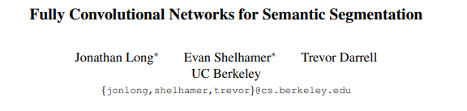
02.
FCN

Slide 9
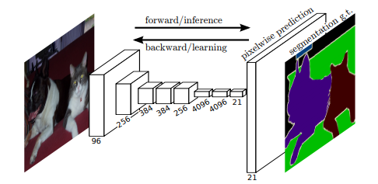
02.
FCN
Pixelwise prediction with end to end learning

Slide 10
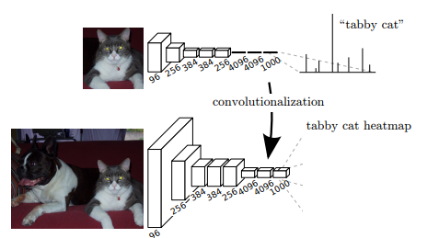
02.
FCN
Convolutionize
Fully convolutional versions of existing networks predict dense outputs from arbitray-sized inputs

Slide 11
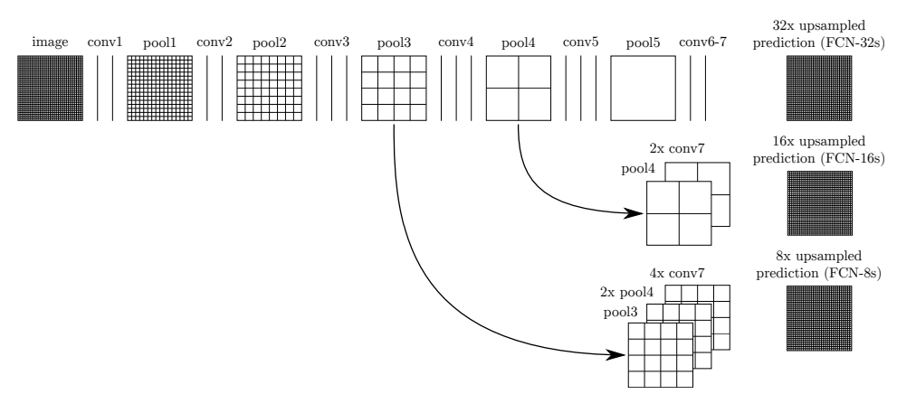
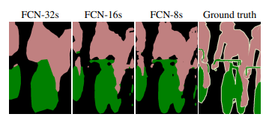
02.
FCN
Skip Connection

Slide 12
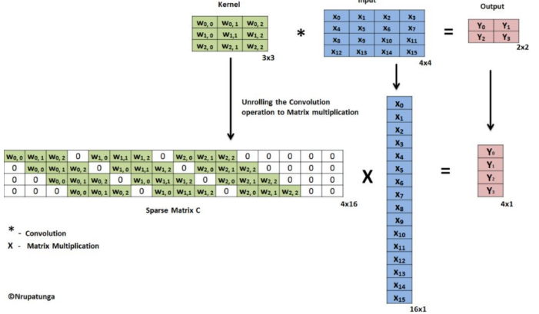
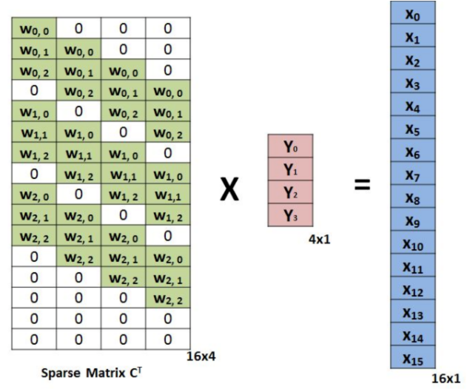
02.
FCN
Transposed Convolution(Deconvolution)
수학적 역관계는 아니지만 연결된 위치를 활용할 수 있다는 점에서 유용한 일종의 interpolation 기법

Slide 13
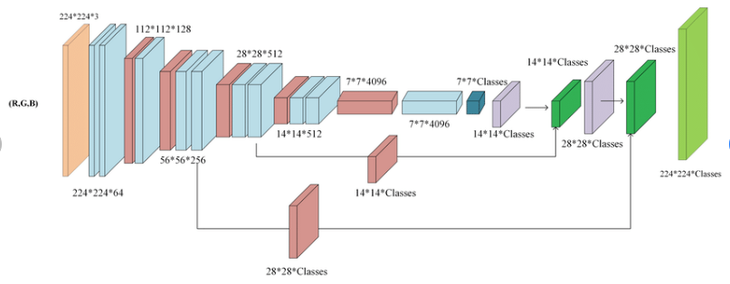
02.
FCN
FCN Architecture

Slide 14
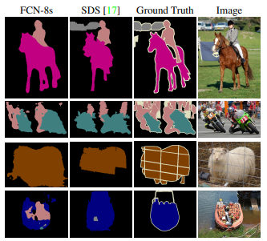
02.
FCN
Works well, but needs to catch more details

Slide 15
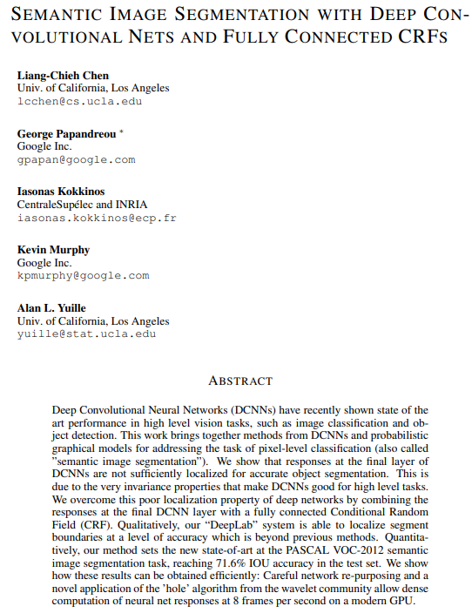
03.
DeepLabV1

Slide 16
03.
DeepLabV1
Two contributions
1.Signal downsmapling:
=>Atrous Algorithm
2.Spatial intensity:
=>Conditional random field

Slide 17
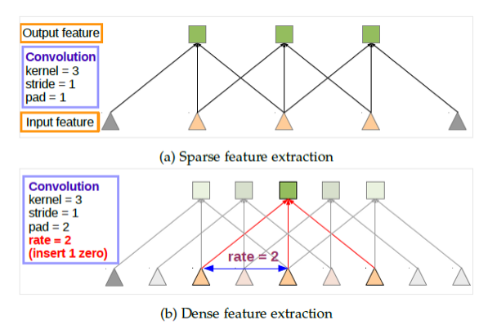
03.
DeepLabV1
Atrous Convolution(Dilated Convolution)
makes the output feature map larger
allows us to enlarge the field of view of filters to incorporate larger context

Slide 18
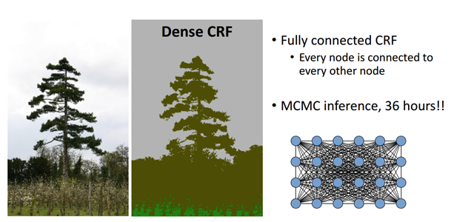
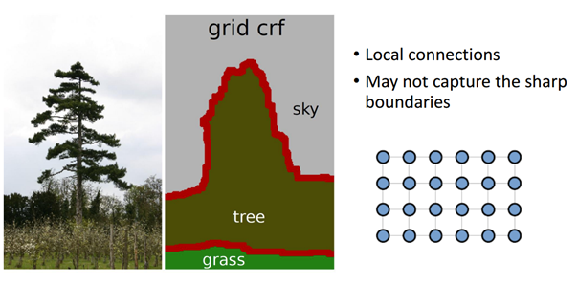
03.
DeepLabV1
Conditional Random Field

Slide 19
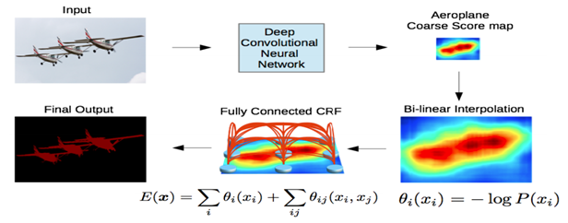
03.
DeepLabV1
Architecture

Slide 20
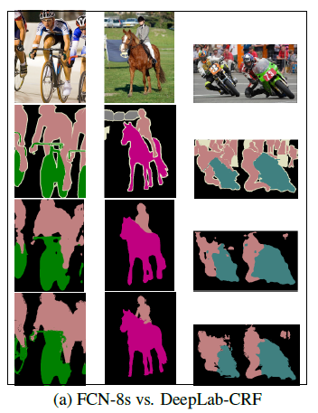
03.
DeepLabV1

Slide 21
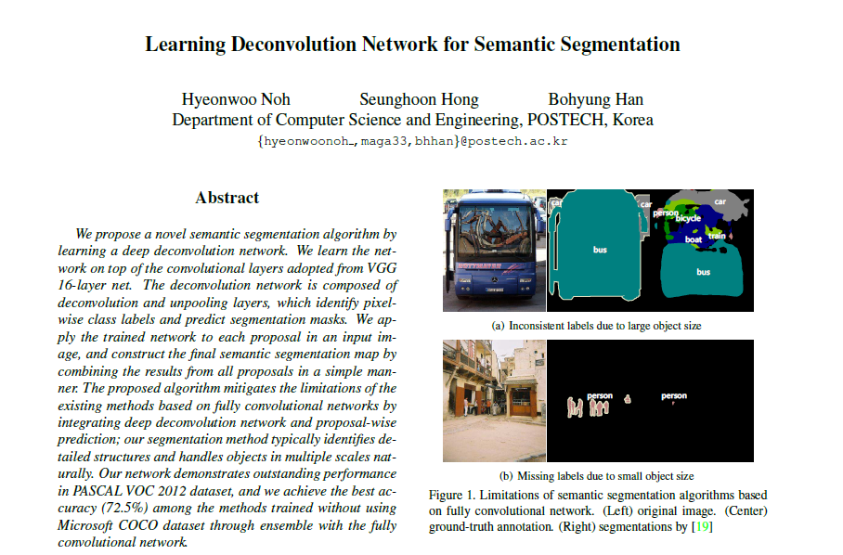
04.
Deconvolutional Network

Slide 22
04.
Deconvolutional Network
Two
Problems
1.Network has a predifined fixed size receptive filed
=>Too small or too big objects neglected
2. Details are often lost

Slide 23
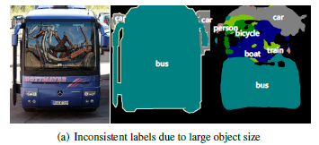
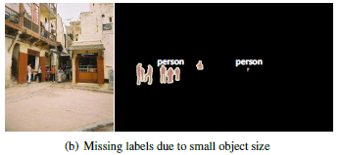
04.
Deconvolutional Network
Too small or too big objects neglected

Slide 24
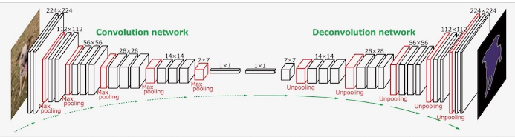
04.
Deconvolutional Network
Deconvolutional layers

Slide 25
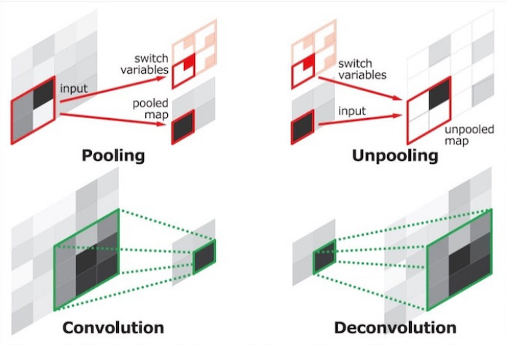
04.
Deconvolutional Network
Unpooling layer

Slide 26
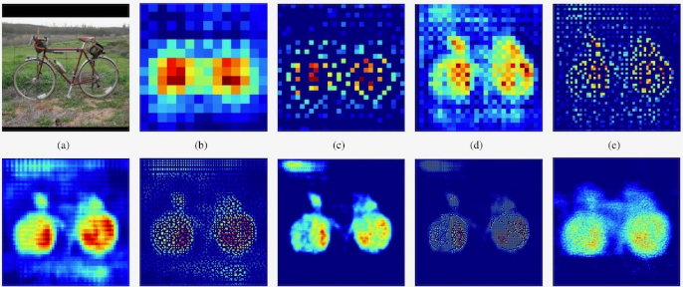
04.
Deconvolutional Network

Slide 27
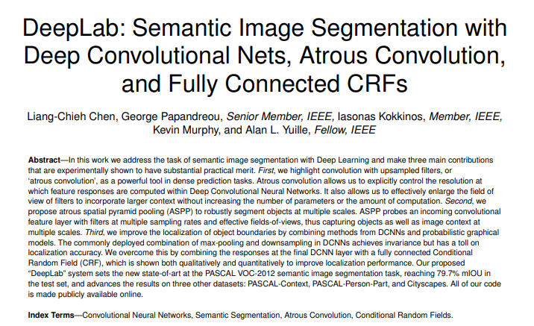
05.
DeepLab V2

Slide 28
05.
DeepLab V2
Challenges
1.Reduced feature resolution
2.Existence of objects at multiple scales

Slide 29
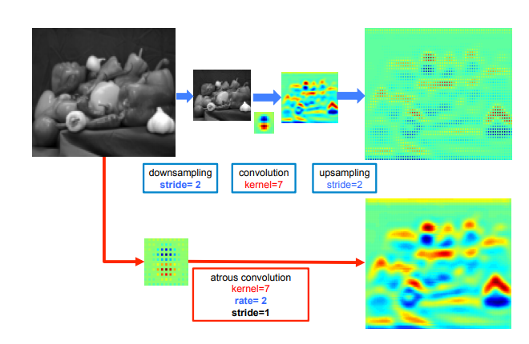
05.
DeepLab V2
Pooling+ CNN vs Atrous convolution

Slide 30
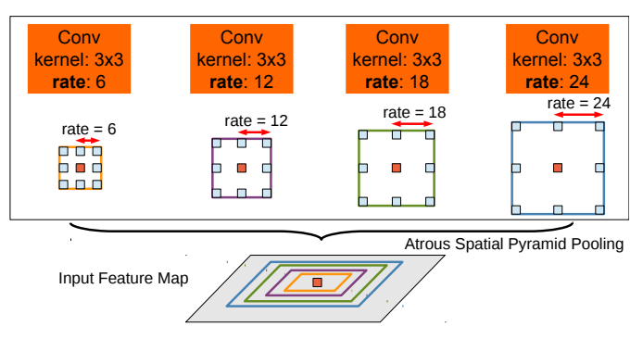
05.
DeepLab V2
Multi-scale solution

Slide 31
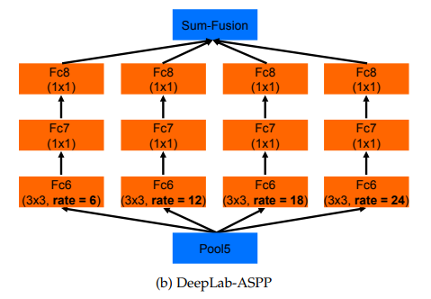
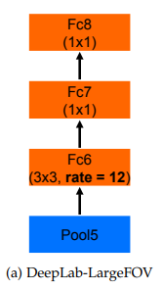
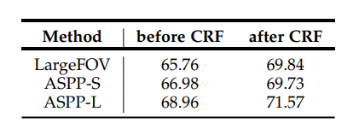
05.
DeepLab V2

Slide 32
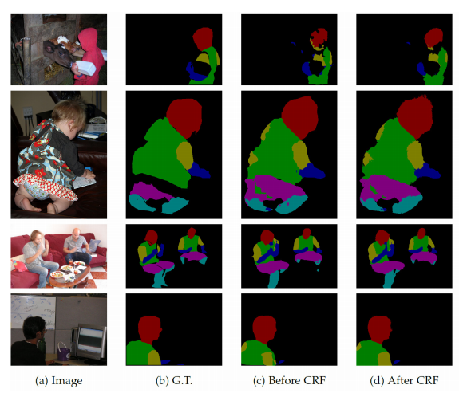
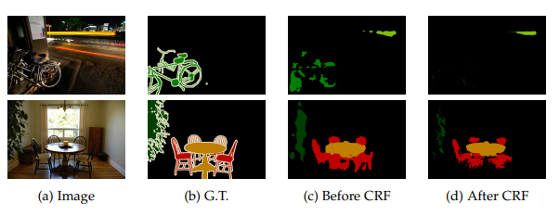
05.
DeepLab V2
CRF

Slide 33
Thank you

